Slide 1

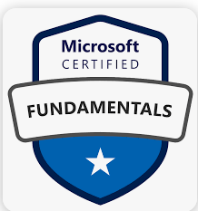
Azure Fundamentals (AZ-900)

Slide 2
Agenda
Cloud concepts
Azure architecture and services
Azure management and governance
Quiz & Lab session
Exam AZ-900 : Microsoft Azure Fundamentals

Slide 3


1. Cloud Concepts

Slide 4
Agenda
Problem with Traditional IT Infrastructure
What is Cloud Computing ?
Benefits Of Cloud Computing
Cloud Service Models
Cloud Deployment Models
Different types of Cloud Providers
Comparison between AWS vs Azure vs GCP

Slide 5
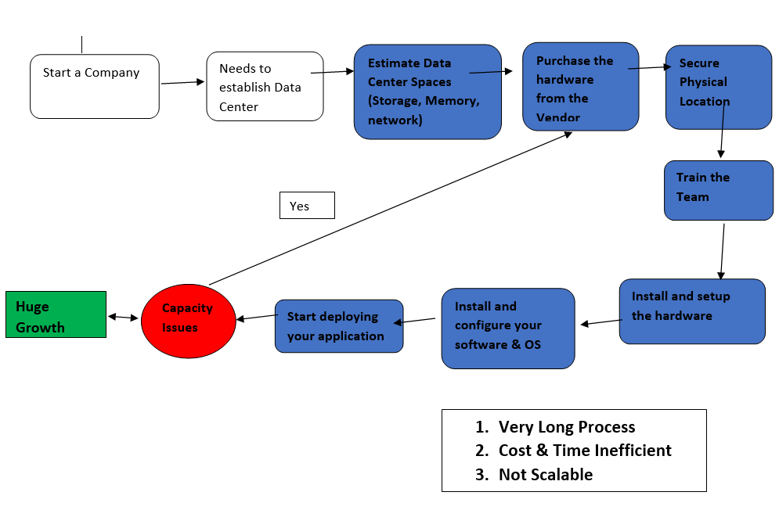
Before Cloud Computing

Slide 6
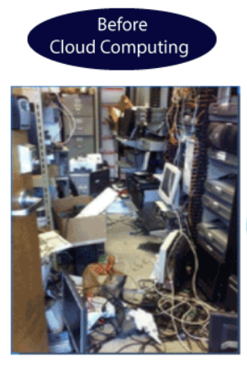
Problem with Traditional IT Infrastructure
Pay the rent for the data center
Pay for power supply, cooling, maintenance
Adding and replacing hardware takes time
Scaling is limited
Hire a team to monitor the infrastructure
How to deal with disasters? (earthquake, fire..etc.)
Notes:
https://blog.certcube.com/cloud-fundamentals/
a large group of networked computer servers typically used by organizations for the remote storage, processing, or distribution of large amounts of data.

Slide 7
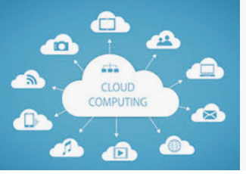
What is Cloud Computing ?
Cloud computing is the on-demand delivery of IT resources through a cloud services platform via the internet with Pay-as-you-go pricing
Access technology services, such as computing power, storage, databases and Networking services.
Example : Gmail , Google drive, Skype,
Whatsup, Netflix, Chatbot …etc.
Notes:
Online storage services like Dropbox, Google Drive, and iCloud
Software as a service (SaaS) applications like Salesforce, Office 365, and G Suite,
Infrastructure as a service (IaaS) which allow businesses and organizations to rent virtualized computing resources, such as servers and storage, over the internet.
Platform as a service (PaaS) providers like Heroku, AppFog, and Google App Engine, which provide a platform for developers to build, run, and manage applications without having to worry about the underlying infrastructure.
Streaming services like Netflix, Amazon Prime Video, and Hulu, which allow users to stream movies and TV shows over the internet.
Social media like Facebook, Twitter, and LinkedIn, which allow users to share information, connect with others, and access a wide range of services over the internet.
Gaming services like Xbox Live, PlayStation Plus, and Steam, which allow users to play games, connect with friends, and access a variety of gaming-related content over the internet.
Now-a-days, Cloud computing is in high demand and a growing technology in today's market. It uses the internet for managing data that is stored on remote servers and then access the same data via the internet. Here, Users can work on the remote just need Internet access. Cloud computing customers use services from a third-party provider and do not own any physical infrastructure, thus reduces overall cost and maintenance expenses. Important characteristics of cloud services that makes it out-standing from traditional methods are:
On-demand self- service
Secure network access
Resource pooling
Rapid elasticity on resources as per requirement
Cloud computing has become so successful because of its simplicity in its usage and flexibility that is offers to its clients. They are really cost-effective solution for every size of enterprises. Here are few Examples of cloud computing that will help to understand the scalability and scope of cloud computing that is trending these days. 1. In Entertainment: Netflix, Amazon Prime, Youtube etc 2. Chatbots: Google Assistant, Siri, Alexa, Meena by Google; BlenderBot by Facebook etc 3. Communication: Emails, Skype and WhatsApp, video conferences 4. Docs management: Microsoft Office 365 and Google Docs 5. Backup tools: Dropbox, Google Drive and Amazon S3 6. Application development: Amazon Lumberyard, Github, GCP, Intellij 7. Big data analytics: Hadoop, Cassandra, HPCC 8. Social Networking: Facebook, LinkedIn, MySpace, Twitter, Instagram etc

Slide 8


Consumption-based Model : CapEx vs OpEx
Capital Expenditure (CapEx) is the Up-front spending of money on physical infrastructure | Operational Expenditure (OpEx) is Spending money on services or products now
Deducting that up-front expense over time | Can deduct this expense in the same year you spend
You own the asset | Pay as you go
Examples: Purchasing an apartment, Car. | Examples: Renting an apartment or mobile bills
Notes:
https://www.youtube.com/watch?v=x1QvruGUdjA&ab_channel=Saidemy
This consumption-based model has many benefits, including:
No upfront costs.
No need to purchase and manage costly infrastructure that users might not use to its fullest potential.
The ability to pay for more resources when they're needed.
The ability to stop paying for resources that are no longer needed.

Slide 9
Before Cloud | After Cloud
Buy physical servers | Rent virtual servers
Keeping the peak traffic in mind, buy more servers | No need Automatically Scale up & Scale down as per traffic
Monitoring and Maintenance of your servers | Taken care by Azure(Zero maintenance Headaches)
The entire setup is more expensive | Cheapest
Troubleshooting problems can be tedious and may conflict with your business goals | Your server will never be going down (Azure is providing SLA)
Since the traffic is varying , your servers will be idle most of the time | Nothing to worry take care by Azure Scalability feature
Can't access from other location | Access from any place in the world
Takes lot of time to Provision | On demand and Quick Provision
Risk of Data loss | Data will never loss
Pay whether use it or not | Pay only for what you use
Wastage of Time | Save your time
Wastage of Money | Generate mor Money

Slide 10
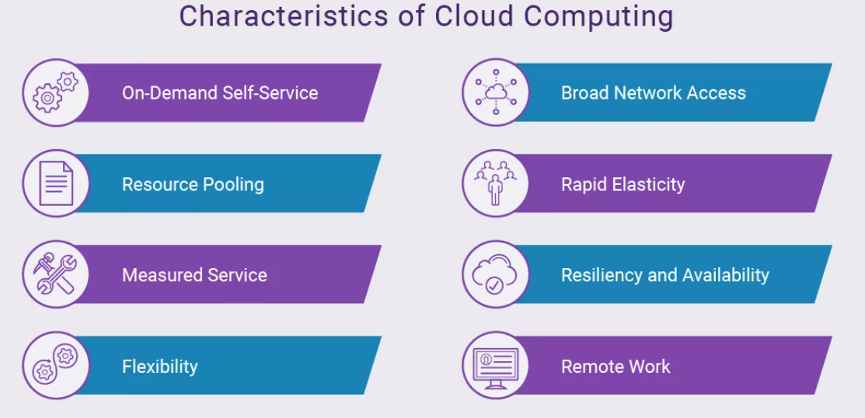
Cloud Computing Characteristics
Notes:
https://www.synopsys.com/cloud/insights/essential-cloud-computing-characteristics.html

Slide 11
Benefits Of Cloud Computing
High availability and Scalability
Reliability and Predictability
Security and Governance
Manageability
Agility
Notes:
Reliability : is the ability of system to recover from failures and continue to function
Predictability : can be focused on performance predictability or cost predictability.
Security : because the cloud is intended as an over-the-internet delivery of IT resources, cloud providers are typically well suited to handle things like distributed denial of service (DDoS) attacks, making your network more robust and secure.
Governance : Whether you’re deploying infrastructure as a service or software as a service, cloud features support governance and compliance. Things like set templates help ensure that all your deployed resources meet corporate standards and government regulatory requirements.
Cloud agility is the ability to quickly develop, test, and launch applications in a cloud-based environment.
7 layers of security:
1. Physical Security 2. Identity and Access 3. Perimeter 4. Network 5. Compute 6. Application 7. Data
We employ more than 3,500 security experts who are dedicated to data security and privacy.
Microsoft invests more than USD 1 billion annually on cybersecurity research and development.

Slide 12
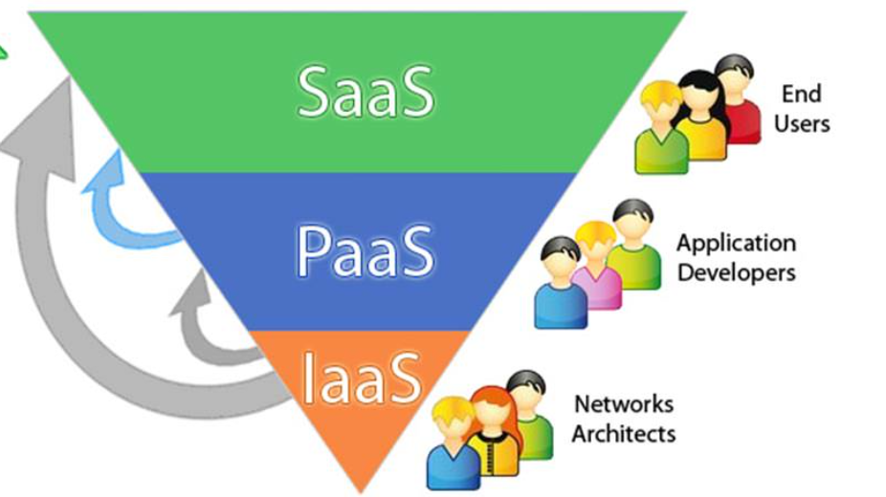
Cloud Service Models
1.IaaS (Infrastructure as a Service)
Examples : VM or EC2 (from AWS), Storage or Networking.
2. PaaS (Platform as a Service)
Examples: Azure SQL DB , Azure Functions, Azure Apps
3. SaaS (Software as a Service)
Examples: Microsoft Office 365, OneDrive, Keka, Outlook

Slide 13
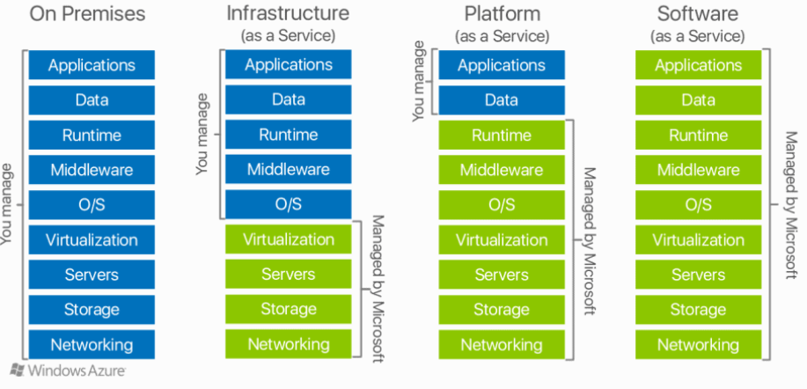
Service Delivery Models

Slide 14
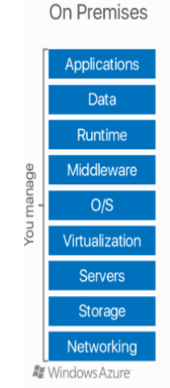
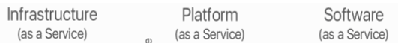
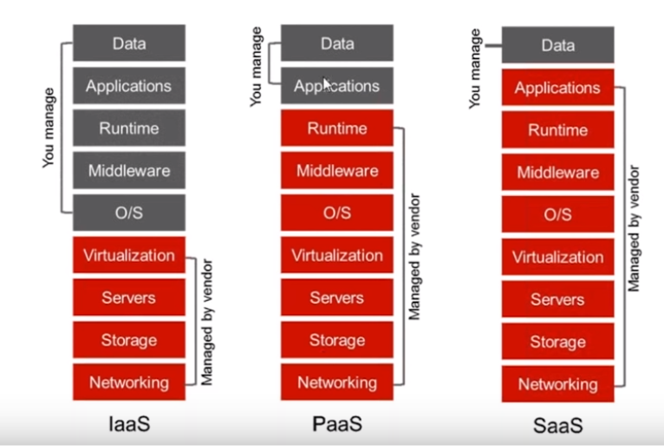
Service Delivery Models
Notes:
Three layers :
Platform : Last 4
Infrastructure : 3
Service : first 2

Slide 15
We will connect bac at

Slide 16
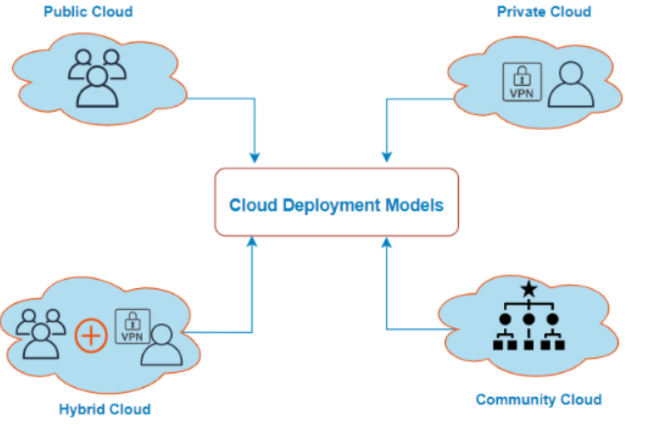
Cloud deployment models
1. Public Cloud
Example: AWS , MS Azure, GCP
2. Private Cloud
Example: HP Data Centers, Microsoft, IBM
3. Hybrid Cloud
Example: Oracle Cloud at Customer, Google cloud Anthos, AWS Outpost
4. Community Cloud
Example : Media and Health care industry, Scientific research
5. Multi Cloud
Notes:
Multi Cloud : We can use multiple public cloud providers
Use different features from different cloud providers
Start with one cloud in future of migrating a different providers we can user

Slide 17
Cloud Providers
Amazon Web Services (AWS)
Microsoft Azure
Google Cloud Platform
IBM Cloud Services
VMware Cloud
Oracle cloud
Red Hat
Digital Ocean
Rackspace
Alibaba Cloud

Slide 18
AWS vs Azure vs GCP As of Q4 2022
 | AWS | Azure | GCP
Cloud Provider | Amazon | Microsoft | Google
Launching Year | 2006 | 2010 | 2008
Availability | 36 Regions | 60+ Regions | 24 Regions
Services | 212+ Services | 200+ Services | 100+ Services
Cloud Market Share | 32% | 23% | 10%
Pricing | Charge Per Hour | Charge Per Minute | Charge Per Minute
Clients | Netflix, BMW, Samsung | Apple, HP, Honeywell | LG, Toyato, Vodafone
Notes:
https://www.simplilearn.com/introduction-to-cloud-computing-basics-skillup

Slide 19
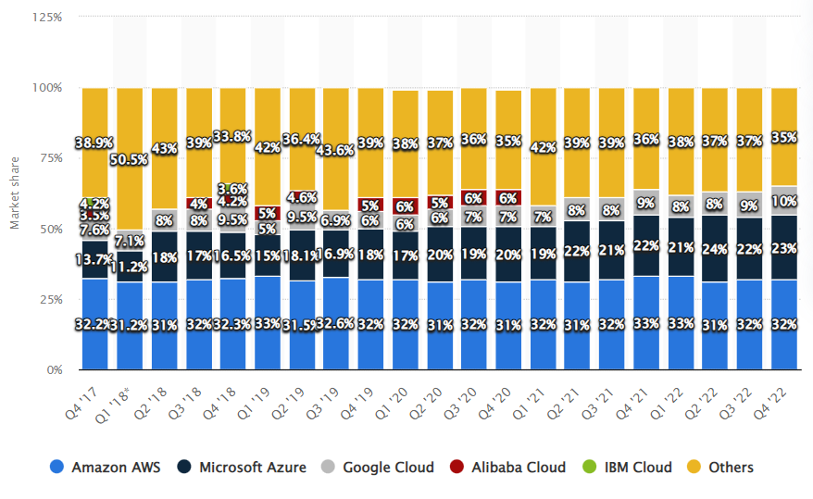
Market Share of Cloud providers
Notes:
https://www.whizlabs.com/blog/aws-vs-azure-vs-google/

Slide 20
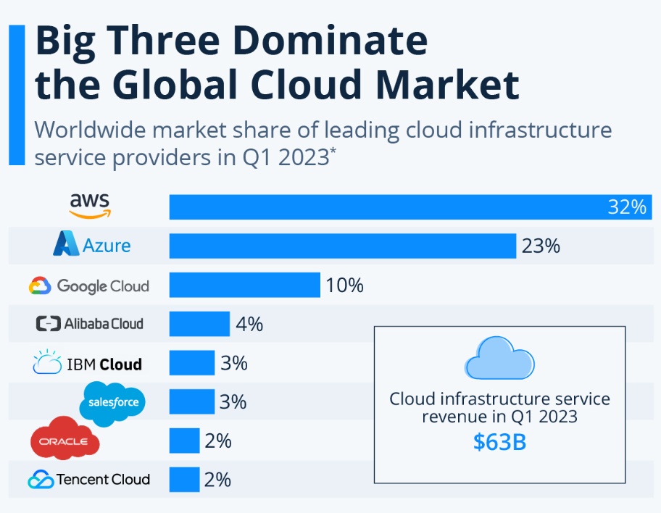
Top 3 Global Cloud provider Market share

Slide 21
Quiz
1. Which of the following describes a benefit of cloud services?
a) Economies of scale b) Fixed workloads c) Unpredictable costs
2. Operational Expenditure is spending money on services or products now and being billed for them now.
a) True b) False
3. Which of the following terms refer to making a service available with no downtime for an extended period of
time ?
a) Agility b) Fault tolerance c) High availability d) Auto scaling
4. Microsoft Office 365 is an example of?
a) IaaS b) PaaS c) SaaS d) DBaaS
5. In Which type of Cloud model are all the hardware resources owned by a third-party and shared between
multiple organizations?
a) Hybrid Cloud b) Private Cloud c) Public Cloud d) Community Cloud

Slide 22
6. According to the shared responsibility model, which cloud service type places the most responsibility on the customer?
A. IaaS B. PaaS C. PaaS
7. Which type of scaling involves adding or removing resources (such as virtual machines or containers) to meet demand?
A. Vertical scaling B. Horizontal scaling C. Direct scaling
8. What is characterized as the ability of a system to recover from failures and continue to function?
A. Reliability B. Predictability C. Scalability
9. What type of cloud service type would a Finance and Expense tracking solution typically be in?
A. Infrastructure as a Service (IaaS) B. Platform as a Service (PaaS) C. Software as a Service (SaaS)
10. You're developing an application and want to focus on building, testing, and deploying. You don't want to worry about managing the underlying hardware or software. Which cloud service type is best for you?
A. IaaS B. PaaS C . SaaS

Slide 23
Q
A

